Slide 1


PENTABYTE
UNIT I: COMPUTATIONAL THINKING AND PYTHON FOUNDATIONS
Notes:
SLIDE 01 — PRESENTER SCRIPT
Good morning everyone! Welcome to PentaByte's Unit I: Computational Thinking and Python Foundations. Today we will explore how we turn everyday problems into clear algorithms, translate those algorithms into Python, and measure how efficiently they work. We will follow one practical example throughout: a collection of student scores. By the end, you should understand not just how to write code, but how to design, test and evaluate a solution. Let's begin!

Slide 2



THE CHALLENGE
Five scores to check: 72, 85, 68, 91, 85
Which is the highest? Easy by eye.
Now imagine 3,000 student scores
We need a reliable, repeatable method
Notes:
SLIDE 02 — PRESENTER SCRIPT
Let's start with five student scores: 72, 85, 68, 91 and 85. Which one is the highest? [Pause for response.] Yes, 91. That's easy when we can see all five values. Now imagine 3,000 student scores. Would checking each one manually still be practical? We need a reliable method that works no matter how many values we are given. That is where an algorithm helps: it gives the computer clear instructions that can be repeated consistently. Let's see how to build one.

Slide 3


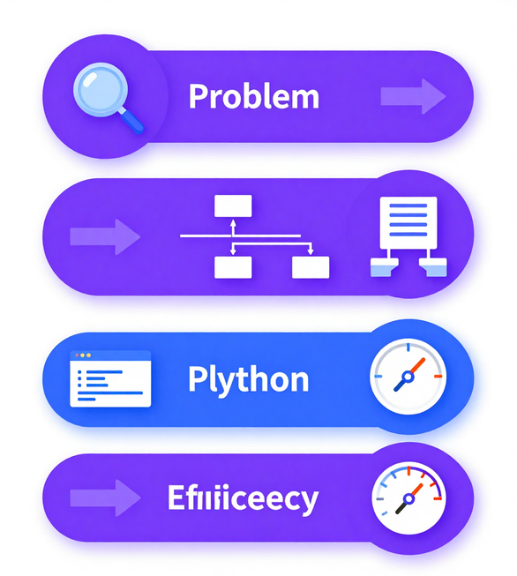
LEARNING PATHWAY
Problem → Algorithm → Python → Efficiency
By the end of Unit I you will be able to:
• Analyse a problem and design a step-by-step algorithm
• Translate pseudocode and flowcharts into working Python
• Measure efficiency using Big-O notation
• Apply computational thinking to real student-score datasets
Notes:
SLIDE 03 — PRESENTER SCRIPT
Our learning pathway consists of four stages: problem, algorithm, Python and efficiency. First, we analyse the task. Next, we describe a step-by-step solution using pseudocode or a flowchart. Then we turn that solution into working Python code. Finally, we investigate how much time and memory it uses as our input grows. These steps connect: good code starts with sound problem-solving, and a working result does not automatically mean an efficient solution. Our student-score example will link the whole journey.

Slide 4


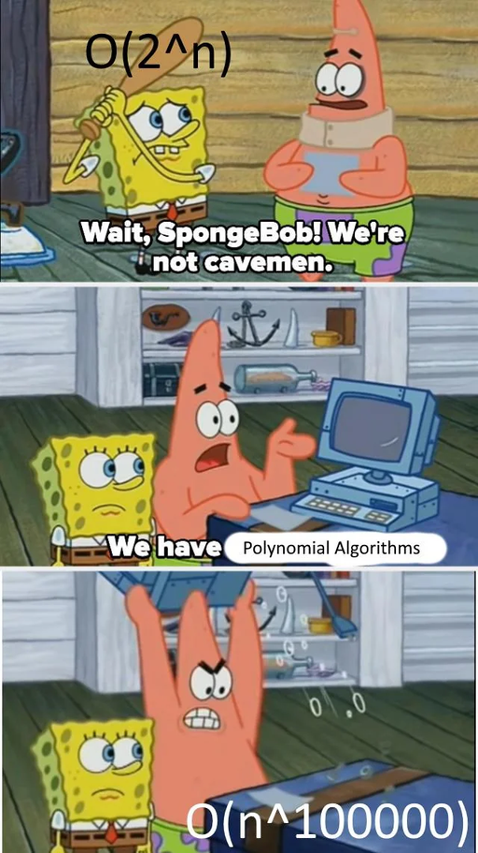
CHAPTER 1
FROM PROBLEMS TO ALGORITHMS
Objective: Turn a real task into precise, repeatable steps Guiding Question: How can we reliably find the highest score?
Notes:
SLIDE 04 — PRESENTER SCRIPT
Chapter 1 is about turning problems into algorithms. An algorithm is a finite, well-defined set of steps that solves a problem. Before writing code, we need to specify exactly what the program must do and consider what could go wrong. Our guiding question is: how can we reliably find the highest score in a list? Instead of guessing at code, we will build a clear method that a person can follow and a computer can execute.

Slide 5

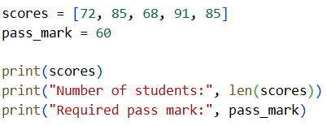


DEFINE THE PROBLEM
Input: a list of student scores, e.g. [72, 85, 68, 91, 85]
Output: the single highest score in the list
Process: inspect every value to find the maximum
Special case: if the list is empty, report no result
Notes:
SLIDE 05 — PRESENTER SCRIPT
We first define the problem. The input is a list of scores, such as [72, 85, 68, 91, 85]. The expected output is one number: the maximum score. The process is to inspect the data and keep track of the largest value. We also need to anticipate special cases. What if the list is empty? There is no highest value to report, so our program should return a clear indication such as None. That gives us four parts of a good problem definition: input, output, process and edge cases.

Slide 6

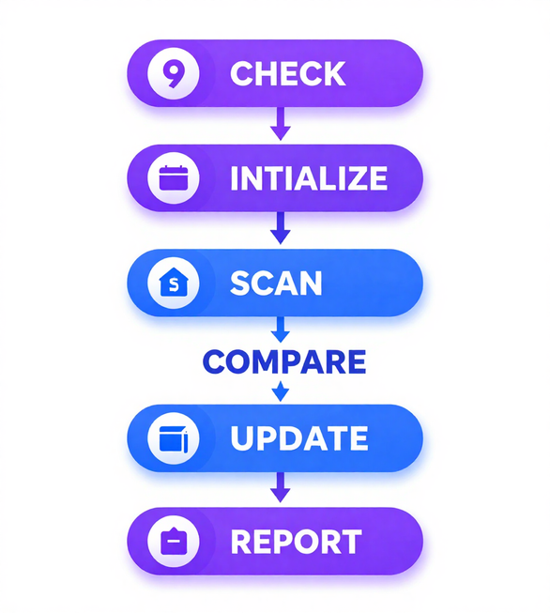
ALGORITHM DECOMPOSITION
Breaking the maximum-finding problem into finite, well-defined steps:
① CHECK — Is the list empty? If yes, report "No scores."
② INITIALIZE — Set current_max = first score
③ SCAN — Visit each remaining score one by one
④ COMPARE — Is this score > current_max?
⑤ UPDATE — If yes, set current_max = this score
⑥ REPORT — Return current_max as the result
Notes:
SLIDE 06 — PRESENTER SCRIPT
Decomposition means breaking a problem into manageable steps. Here are our six steps. First, CHECK whether the list is empty. Second, INITIALIZE the current maximum with the first score. Third, SCAN the remaining scores one by one. Fourth, COMPARE each score with the stored maximum. Fifth, UPDATE the maximum when we find something larger. Sixth, REPORT the final answer. Notice we do not have to store all earlier comparisons. We just keep one value representing the largest score seen so far.

Slide 7

Pseudocode is language-independent logic — written in plain English, structured like code, readable by anyone.
Complete Highest-Score Pseudocode:
BEGIN find_highest_score(scores)
IF scores is empty THEN
RETURN None
END IF
SET highest ← scores[0]
FOR EACH score IN scores DO
IF score > highest THEN
SET highest ← score
END IF
END FOR
RETURN highest
END
Key ideas: initialise → scan → compare → update → report.
Notes:
SLIDE 07 — PRESENTER SCRIPT
This is pseudocode: a structured way to describe logic without committing to Python syntax. We begin a procedure called find_highest_score. If the list is empty, we return None. Otherwise, we set highest to the first score. We examine the scores; whenever a score exceeds highest, we update highest. Finally, we return highest. The core idea is initialize, scan, compare, update and report. Starting with the first actual score is safer than assuming zero is an appropriate starting maximum. Pseudocode lets us check our logic before worrying about code syntax.

Slide 8

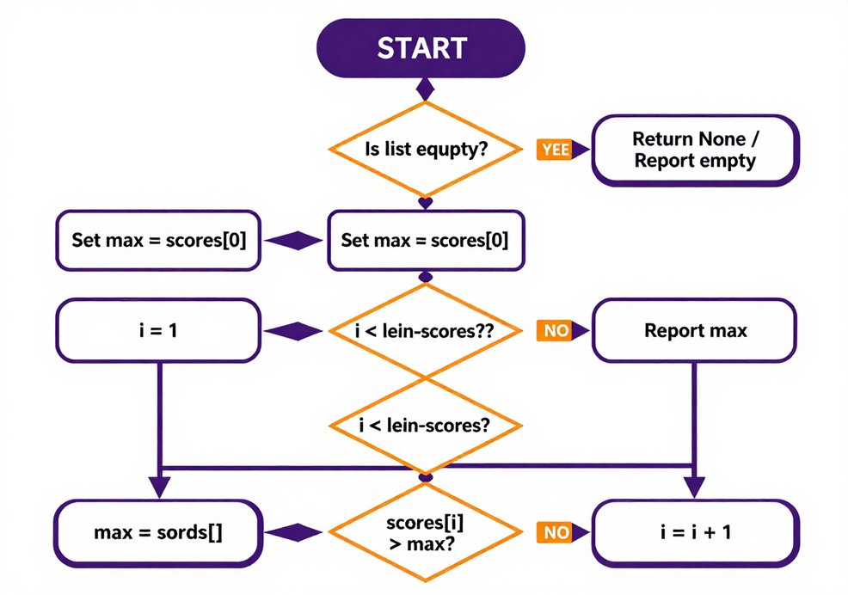

FLOWCHART — MAXIMUM-FINDING DECISION FLOW
Notes:
SLIDE 08 — PRESENTER SCRIPT
A flowchart is a visual version of the same algorithm. Follow the arrows starting at START. The first decision checks whether the list is empty. If it is, we return no maximum and stop. Otherwise, we set a starting maximum and scan the remaining elements. At each comparison we decide whether the new score is greater than our stored maximum. If yes, we update it; if not, we keep the current value. When there are no more scores, we report the maximum. The key idea is that decisions and loops can be drawn visually as well as written in pseudocode.

Slide 9

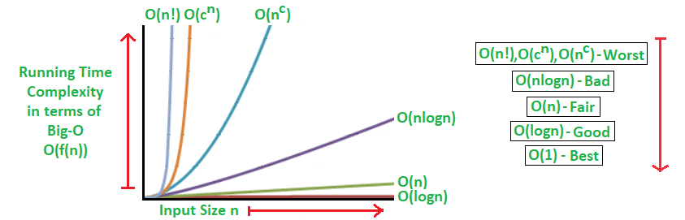
TRACE THE EXAMPLE
Processing scores = [72, 85, 68, 91, 85] — tracking highest at each step; final result: 91
Notes:
SLIDE 09 — PRESENTER SCRIPT
Let's trace the algorithm. Our scores are 72, 85, 68, 91 and 85. Start with highest equal to 72. Compare 85: it is larger, so highest becomes 85. Compare 68: it is smaller, so highest stays 85. Compare 91: it is larger, so highest becomes 91. Compare the final 85: it is smaller, so highest remains 91. The final answer is 91. Tracing makes an algorithm's changing state visible and helps us find mistakes when a program returns the wrong result.

Slide 10


Test Edge Cases — Validate Your Algorithm
Edge Case 1 — Repeated Maximum: [85, 91, 91, 72] → Highest: 91 ✓ (handles ties correctly)
Edge Case 2 — Single Value: [42] → Highest: 42 ✓ (no comparisons needed)
Edge Case 3 — Empty List: [] → Returns: 0 ✓ (special-case guard triggers)
🔮 Prediction Task: find_highest_score([72, 85, 68, 91, 95])
Trace each comparison — what is the final highest score?
▶ Answer Reveal: 95 — the algorithm correctly scans all 5 values and updates the running maximum twice (72→85, then 85→91, then 91→95), returning 95.
Notes:
SLIDE 10 — PRESENTER SCRIPT
A single successful example is not enough: we should test edge cases. With [85, 91, 91, 72], the maximum is still 91, even though it occurs twice. With [42], the answer is 42 and no further comparisons are needed. With an empty list, our Python function is designed to return None, not a numeric maximum. Now predict the result for [72, 85, 68, 91, 95]. [Pause.] The running maximum changes from 72 to 85, then to 91, and then to 95. So the answer is 95. Notice that's three updates after initialization. Presenter note: the current visible slide contains an inconsistent empty-list result and update count; clarify these verbally.

Slide 11


CHAPTER 1 RECAP — FROM PROBLEMS TO ALGORITHMS
Key Takeaways
  Every algorithm starts with a clearly defined problem: know your input, output, and process.
  Decomposition breaks a complex task into finite, well-defined steps — check, initialize, scan, compare, update, report.
  Pseudocode and flowcharts express logic independently of any programming language.
  Edge cases (empty list, repeated maximum) must be anticipated before writing a single line of code.
Up Next → Chapter 2: We translate this algorithm into executable Python code.
Notes:
SLIDE 11 — PRESENTER SCRIPT
Let's recap Chapter 1. We defined the problem by identifying inputs, outputs, the process and edge cases. We decomposed the task into clear steps. We expressed our solution as pseudocode and a flowchart, and we checked its behaviour by tracing examples and testing unusual inputs. We now have a complete logical method. But pseudocode cannot be executed directly. In Chapter 2 we will convert our algorithm into working Python.

Slide 12

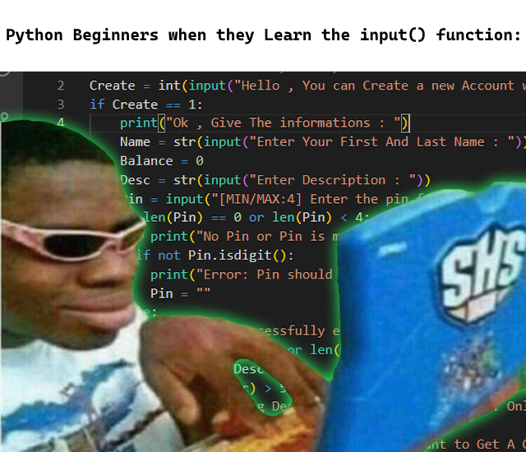
CHAPTEER 2
ESSENTIAL PYTHON
From pseudocode to executable code
Notes:
SLIDE 12 — PRESENTER SCRIPT
Welcome to Chapter 2: Essential Python. We already know how our highest-score algorithm should work. Now we need to express those steps in a programming language. Python is a useful starting point because it has readable syntax. We'll learn the building blocks: variables, lists, conditions, loops and functions. We'll use those tools to turn our algorithm into an actual program. You do not need to memorize everything at once: focus on what each instruction contributes to the solution.

Slide 13

NOTEBOOK & FIRST PROGRAM
Jupyter Notebook: code runs in cells — execute with Shift+Enter. Each cell holds statements.
Variables & Types:
student_name = "Alice" # string
score = 91 # integer
scores = [72, 85, 68, 91, 85] # list
Key built-ins:
print(score) → 91
print(len(scores)) → 5
print(scores[0]) → 72 # index from 0
Assignment stores a value in a named memory location.
Lists hold ordered, indexed items — len() returns the count.
Notes:
SLIDE 13 — PRESENTER SCRIPT
We can work in Jupyter Notebook, where code runs in cells. To execute a cell, press Shift and Enter. Here are three variables: student_name holds a string such as Alice, score holds an integer like 91, and scores holds an ordered list of numbers. Python lists use zero-based indexing, so scores[0] is 72, not 85. The function len(scores) returns the number of items, which is five. The print function displays values. These basic operations let us store data, inspect it and see our results.

Slide 14

Conditions and Loops in Python
if score >= pass_mark: # True or False?
print("Pass") # runs only when True
else:
print("Fail") # runs only when False
for score in scores: # repeat for every score
if score >= pass_mark:
count += 1 # update counter
• Indentation (4 spaces) defines code blocks — not optional
• The loop visits each value once: repeated processing
• Condition evaluated fresh on every iteration
Notes:
SLIDE 14 — PRESENTER SCRIPT
Conditions let a program make decisions. For example, if score is greater than or equal to pass_mark, print Pass; otherwise, print Fail. The comparison is evaluated as true or false. Loops let us repeat operations. A for loop visits each score in our list, and we can place an if statement inside it to count passing scores. Each occurrence is checked separately. Python indentation matters: statements indented under if or for belong to that block. If the indentation changes, the meaning or validity of the program may change.

Slide 15
Functions: def, Parameters & return
def count_passing(scores, pass_mark):
count = 0
for score in scores:
if score >= pass_mark:
count += 1
return count
• def defines a reusable block of code with a name
• Parameters (scores, pass_mark) are inputs passed in when called
• return sends the result back to the caller
• Call it: count_passing([72, 85, 68, 91, 85], 70) → 3
• Functions avoid repeating code — write once, use many times
Notes:
SLIDE 15 — PRESENTER SCRIPT
A function is a reusable block of code. We define one using def. Our count_passing function takes two parameters: scores and pass_mark. It begins with count equal to zero, visits every score, adds one whenever a score meets the pass mark, and finally returns the count. Parameters are inputs supplied when we call the function; return sends the result back to the caller. For example, count_passing([72, 85, 68, 91, 85], 70) returns 3. Write the logic once, and you can reuse it with different data and thresholds.

Slide 16

Testing count_passing( )
pass_mark = 60 → count = 5 (72, 85, 68, 91, 85 all ≥ 60)
pass_mark = 80 → count = 3 (85, 91, 85 pass; 72 and 68 fail)
empty list [ ] → count = 0 (loop never executes; returns 0)
Repeated scores (85 appears twice): each value is checked independently — both count if ≥ pass_mark.
Notes:
SLIDE 16 — PRESENTER SCRIPT
Let's test count_passing with different pass marks. At 60, all five scores qualify, so the answer is 5. At 80, the scores 85, 91 and 85 qualify, so the answer is 3. With an empty list, the loop has no iterations and count remains zero. The repeated value 85 is counted twice because the loop processes each list position. Ask yourself: if the pass mark became 90, what would happen? [Pause.] Only 91 passes, so the function returns 1. This shows why changing inputs is a valuable way to test reusable functions.

Slide 17

HIGHEST-SCORE PYTHON FUNCTION
def find_highest_score(scores):
if len(scores) == 0:
return None # empty list → return None
highest = scores[0] # initialise with first value
for i in range(1, len(scores)): # range(1,n) skips index 0
if scores[i] > highest:
highest = scores[i]
return highest
► scores[0] — safe starting value; avoids a dummy like −∞
► range(1, len(scores)) — iterates indices 1 … n−1 (n−1 comparisons)
► Returns None when the list is empty so callers can check safely
Notes:
SLIDE 17 — PRESENTER SCRIPT
Now we implement find_highest_score in Python. First, if len(scores) equals zero, return None so we do not try to access a missing first element. Otherwise, set highest to scores[0]. The loop uses range(1, len(scores)), meaning indices one through the last valid position. We skip index zero because it is already our starting maximum. For each index, compare scores[i] with highest, updating highest only when the new score is larger. Then return highest. This code follows precisely the algorithm we designed in Chapter 1.

Slide 18


CHAPTER 2 — PRACTICE & RECAP
Practice: Predict the output of count_passing(scores, 90)
→ scores = [72, 85, 68, 91, 85] | pass_mark = 90
→ Answer: 1 (only 91 qualifies)
Predict: count_passing([], 60)
→ Empty list → function returns 0 immediately (len check)
Key Takeaways:
• Functions encapsulate reusable logic — write once, call many times
• Always handle edge cases: empty input, no qualifiers
• Python indentation defines scope — one wrong indent breaks logic
→ Ready for Chapter 3: How efficient is our algorithm?
Notes:
SLIDE 18 — PRESENTER SCRIPT
Let's practise. For scores [72, 85, 68, 91, 85], what is count_passing(scores, 90)? [Pause.] Only the score 91 qualifies, so the output is 1. What about count_passing([], 60)? The loop does not execute and the function returns 0. That is different from find_highest_score([]), which returns None because an empty list has no maximum. Remember our main Python concepts: variables store values; if and else make decisions; loops repeat steps; functions package reusable logic; and indentation defines code blocks. Now let's ask how efficient our algorithm is.

Slide 19


CHAPTER 3
MEASURING ALGORITHM EFFICIENCY
Why does it matter whether we process 30 scores or 3,000?
Notes:
SLIDE 19 — PRESENTER SCRIPT
Welcome to Chapter 3: Measuring Algorithm Efficiency. Our Python code finds the right maximum, but will it still work efficiently for 30 scores? For 3,000? For millions? Correctness and efficiency are different questions. We will investigate how the number of operations changes as input gets bigger and how much additional memory the algorithm uses. This leads to Big-O notation, time complexity and space complexity.

Slide 20

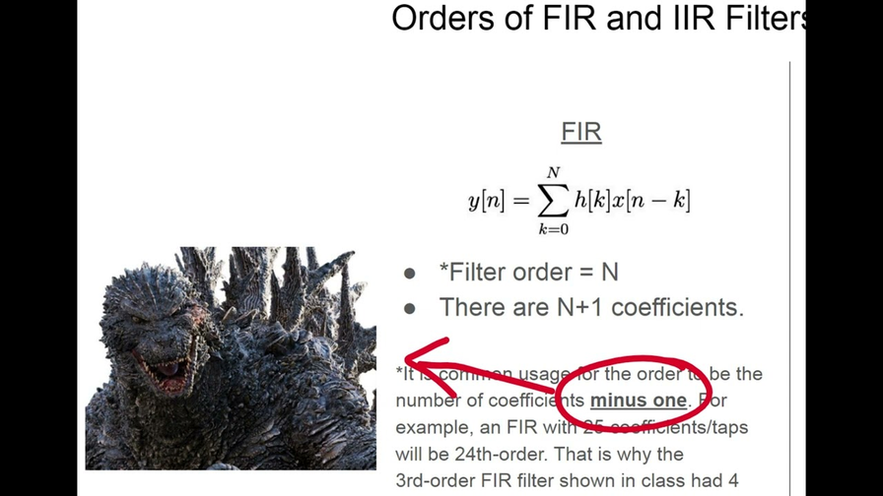
COUNT OPERATIONS
n = total number of scores in the list
A linear scan makes exactly n − 1 comparisons
5 scores → 4 comparisons
30 scores → 29 comparisons
50 scores → 49 comparisons
3,000 scores → 2,999 comparisons
Notes:
SLIDE 20 — PRESENTER SCRIPT
Let's count a specific operation: comparisons. Our maximum-finding algorithm begins with the first score as the current maximum. It then compares every remaining score exactly once. For a nonempty list with n values, that means n minus one comparisons. Five scores require four comparisons; 30 need 29; 50 need 49; and 3,000 need 2,999. These exact counts help us see the growth pattern. The work rises roughly in direct proportion to the number of inputs. This is linear growth.

Slide 21
RUNTIME VS. GROWTH PATTERNS
Measured time depends on hardware and load. Growth pattern depends only on algorithm logic. Big O describes how an algorithm's step count grows as input size n increases — not the exact seconds it takes to run.
Notes:
SLIDE 21 — PRESENTER SCRIPT
Runtime and growth patterns are related but different. Actual runtime is measured in seconds, and it can change with hardware, background load or the programming environment. A growth pattern describes how the number of operations increases as input size n grows. Big O is used to describe the general growth of an algorithm's work or memory use. It is not a stopwatch: O(n) does not tell us the precise seconds a program will take. Instead, it tells us how the work scales.

Slide 22

O(1) — Constant Time
Time does not grow with input size. Always one step.
first = scores[0] # same speed for 5 or 5,000 scores
O(n) — Linear Time
One operation per item; doubles when input doubles.
for score in scores: # visits every score once
if score > highest: highest = score
O(n²) — Quadratic Time
A loop inside a loop; grows very fast with larger input.
for i in scores:
for j in scores: # n × n = n² comparisons
...
Notes:
SLIDE 22 — PRESENTER SCRIPT
Let's compare three complexity classes. O(1) is constant time: accessing scores[0] by index takes a fixed amount of work in the standard Python list model. O(n) is linear time: scanning each score once grows proportionally to n. Our maximum-finding scan is O(n). O(n squared) is quadratic time: for example, a full loop inside another full loop processes n times n pairs. Doubling input size roughly quadruples that work. These categories help us evaluate whether an approach will remain practical as datasets grow.

Slide 23
COMPARE GROWTH RATES
Conceptual operation counts — NOT measured time. As n grows, O(n²) explodes. Nested loops cause n²: for each of n items, scan n items again = n×n operations.
n=5 → O(n)=5, O(n²)=25 | n=10 → O(n)=10, O(n²)=100
n=50 → O(n)=50, O(n²)=2,500 | n=100 → O(n)=100, O(n²)=10,000
Notes:
SLIDE 23 — PRESENTER SCRIPT
Here are conceptual operation counts, not measured runtime. When n is 5, linear growth gives about 5 units of work while quadratic growth gives 25. At n equal to 10, that's 10 versus 100. At n equal to 50, it is 50 versus 2,500. At n equal to 100, it is 100 versus 10,000. Ask the audience which curve they would prefer at large n. The key lesson is not that all quadratic algorithms are wrong: it is that their work grows much faster, so input size matters.

Slide 24
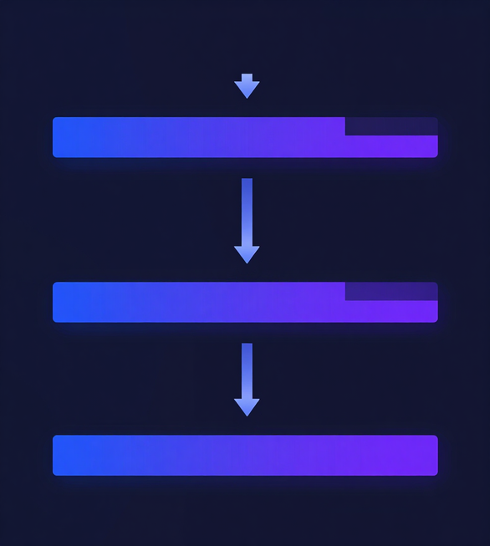
PREVIEW: O(LOG N)
Repeated halving: each step cuts the remaining data in half — far fewer operations than O(n).
Binary search finds a value in a sorted list by repeatedly halving the search space.
• n = 1,000 → ~10 steps | n = 1,000,000 → ~20 steps
⚠ Requires sorted data. Full method taught in Unit II.
Notes:
SLIDE 24 — PRESENTER SCRIPT
Let's preview O(log n), or logarithmic growth. Imagine looking for a word in a dictionary by repeatedly opening near the middle and discarding half the remaining pages. Binary search works in a similar way on sorted data. It checks a middle element and eliminates roughly half the candidates each time. About 1,000 items take around 10 halving steps and about a million take around 20. The crucial condition is that the data must be sorted. We will study the full method in Unit II.

Slide 25


SPACE COMPLEXITY
Memory used by an algorithm matters at scale
Input space — memory occupied by the input data itself
Auxiliary space — extra memory the algorithm allocates
Space complexity = input space + auxiliary space
Notes:
SLIDE 25 — PRESENTER SCRIPT
So far we have focused on work and time, but memory also matters. Space complexity describes how memory requirements grow with input size. Input space is the memory used by the data supplied to the algorithm. Auxiliary space is the extra working memory the algorithm requires. These are different: a list of 5,000 scores already occupies memory before our maximum-finding function starts. The key question is whether our function creates another structure that grows with the list or just uses a small fixed amount of additional storage.

Slide 26

NO-COPY MAXIMUM SCAN
def find_highest_score(scores):
if len(scores) == 0:
return None
highest = scores[0]
for i in range(1, len(scores)):
if scores[i] > highest:
highest = scores[i]
return highest
Time Complexity: O(n) — one comparison per element, n−1 total comparisons.
Auxiliary Space: O(1) — only the variable 'highest' is created regardless of input size.
No new list is allocated; the scan reads the original list in place.
Notes:
SLIDE 26 — PRESENTER SCRIPT
Look at the no-copy maximum scan. It reads the existing scores list, stores the current maximum in highest, and uses an index during the loop. It never creates a second list. For n positive scores it performs n minus one comparisons, giving O(n) time complexity. It uses only a fixed number of working variables, giving O(1) auxiliary space. Constant auxiliary space does not mean that the original input list requires no memory; it means the algorithm's extra memory does not grow with n.

Slide 27

Copy & Slice — O(n) Additional Space
scores.copy() → creates a brand-new list in memory
scores[1:] → creates a brand-new list (all but first)
Both allocate O(n) extra space proportional to list size
Original list is untouched; two lists exist simultaneously
Notes:
SLIDE 27 — PRESENTER SCRIPT
Now consider scores.copy() or scores[1:]. The first creates a new list containing all the original elements. The second creates a list containing all but the first. In both cases, the extra list becomes larger as the input gets larger, so the additional space is O(n). Neither operation modifies the original list. Copying can be useful when you need an independent collection, but it consumes additional memory. If your task is simply to read values and find a maximum, a new list is not necessary.

Slide 28

COMPARE APPROACHES
Both approaches run in O(n) time — n−1 comparisons either way.
Auxiliary space differs:
No-copy scan → O(1): only one variable (current_max)
Copy: scores.copy() → O(n) extra list in memory
Slice: scores[1:] → O(n) extra list in memory
Worked comparison (n = 5,000 scores):
No-copy: stores 1 integer extra — constant, tiny
Copy/slice: duplicates all 5,000 values — grows with n
Conclusion: prefer no-copy scan when memory is limited;
both are equally fast in terms of time complexity.
Notes:
SLIDE 28 — PRESENTER SCRIPT
Compare the alternatives. We can scan the original list directly, or we can first create a copy or slice and then scan. Each complete maximum scan is O(n) time, and making the copy or slice is also O(n), so the overall approach remains O(n) time asymptotically. But the no-copy scan has O(1) auxiliary space, while a copied list requires O(n) additional space. For 5,000 scores, the difference is fixed working storage versus an extra list of thousands of entries. These approaches have the same Big-O time class, not necessarily identical real-world runtime.

Slide 29

Chapter 3 Practice
▸ Scale up: from 30 scores → 3,000 scores, how many comparisons?
▸ Answer: n − 1 = 3,000 − 1 = 2,999 comparisons (was 29 for n = 30)
▸ No-copy maximum scan: auxiliary space stays O(1) regardless of n
Notes:
SLIDE 29 — PRESENTER SCRIPT
Let's practise Chapter 3. If our input grows from 30 scores to 3,000, how many maximum comparisons do we need? Use the formula n minus one. [Pause.] That gives 2,999 comparisons, compared with 29 for a list of 30. Now ask: does our no-copy maximum scan's auxiliary space grow with input size? No. It still uses a fixed number of working variables, so its auxiliary space complexity stays O(1). The input itself grows, but our additional working memory does not.

Slide 30
UNIT I REVIEW — KNOWLEDGE CHECK
Q1: What are the four parts of problem definition? → Input, output, process, edge cases.
Q2: What makes an algorithm valid? → Finite, well-defined, unambiguous steps.
Q3: What does pseudocode achieve? → Language-independent logic description.
Q4: Highest of [72,85,68,91,85]? → 91 (scan and compare all values).
Q5: How many comparisons for n=5? → n−1 = 4 comparisons.
Q6: What is O(n) time complexity? → Runtime grows linearly with input size n.
Q7: What is auxiliary space for no-copy scan? → O(1) — no extra list allocated.
Q8: What does find_highest_score return for []? → None (empty-list guard at start).
Notes:
SLIDE 30 — PRESENTER SCRIPT
We have reached our Unit I knowledge check. Let's review eight core questions together. What four parts help define a problem? Input, output, process and edge cases. What makes an algorithm valid? Finite, well-defined, unambiguous steps. What is pseudocode? A language-independent description of logic. What is the highest score in our original list? 91. How many comparisons for five elements? Four. What does O(n) express? Linear growth in work with input size. What is the no-copy scan's auxiliary space? O(1). And what does find_highest_score return for an empty list? None. Pause briefly after each question to invite answers.

Slide 31

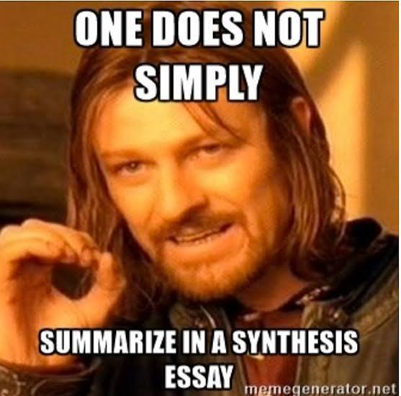
SYNTHESIS
The highest score is 91. Our algorithm scanned all values in O(n) time with O(1) auxiliary space. Python turned pseudocode into executable, testable code. Algorithm design, implementation, and efficiency analysis are one unified process — the foundation of computational thinking.
Notes:
SLIDE 31 — PRESENTER SCRIPT
Let's connect the whole unit. We began with the task of finding the highest score and discovered that the answer to our original example is 91. We defined the problem and edge cases, designed clear steps, wrote pseudocode and a flowchart, implemented the steps in Python, and tested the result. Finally, we found that our scan takes O(n) time and O(1) auxiliary space. Computational thinking is not just coding: it is the connected process of analysing, designing, implementing, testing and evaluating a solution.

Slide 32


BRIDGE TO UNIT II: WHAT COMES NEXT?
We can now find the highest score efficiently — but what if we need to find any score instantly, without scanning every element? The answer lies in how we organise data. Unit II explores data structures: the tools that determine not just how we process information, but how we store and retrieve it. The question is no longer "how many steps?" — it is "what shape should our data take?"
Unit II: Data Structures and Organisation — coming next.
Notes:
SLIDE 32 — PRESENTER SCRIPT
We now know how to find the highest score efficiently. But what if we need to locate a particular score or student record without checking every item one by one? The organisation of the data itself can make retrieval easier or faster. That is the central idea of Unit II: Data Structures and Organisation. We will explore how different structures affect storing, accessing, searching and changing information. In Unit I we learned how to design algorithms. In Unit II we will investigate how the shape of our data can help those algorithms work better. Thank you for your attention!

